Slide 1
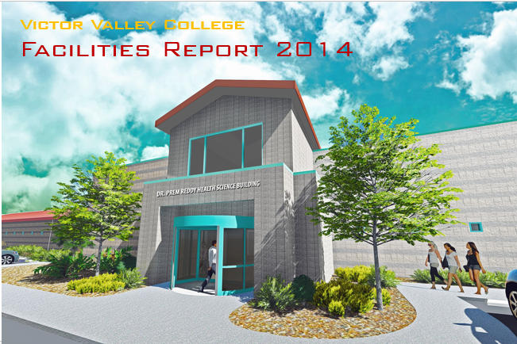

Slide 2

Program Update
The following summarizes major activities completed or in progress as of September 30, 2014.
Program Budget Summary (Attachment A)
The attached Bond Program Budget Summary has been revised to reflect the current priorities and plans
and include bond revenues, expenditures and balances through September 30, 2014. The project list
has been updated to incorporate the Board approved projects that will be funded by the remaining
revenues.
The total program budget including earned interest is $139,897,093

Slide 3

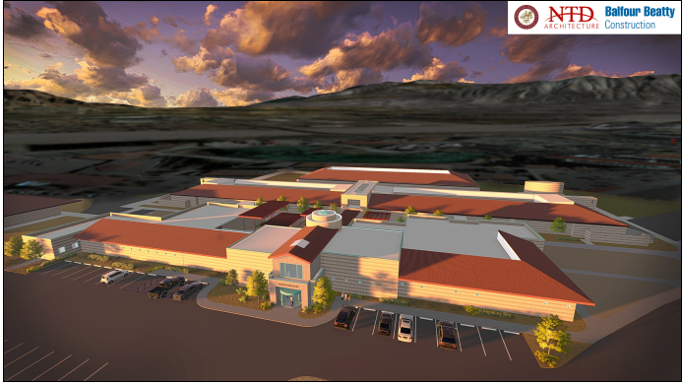
Victor Valley College selected Balfour Beatty Construction and NTD Architecture to construct a 25,000 square foot Health & Sciences Building. It will be a one-story structure located adjacent to and on the west side of the existing Science Building 31. The new building will have additional Life and Physical Science Labs, highly specialized Training Labs for the Nursing program, all integrated with indoor and outdoor student gathering and study spaces to promote a collaborative and technology driven learning environment. Together Balfour Beatty/NTD have completed over 30 educational projects totaling over $600 million throughout Southern California. The team will contract with local consulting firms and contractors to provide training and jobs for the local community.

Slide 4
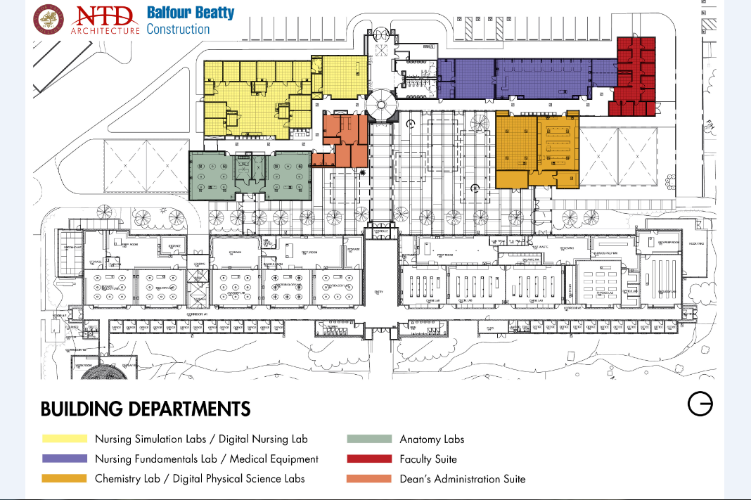

Slide 5
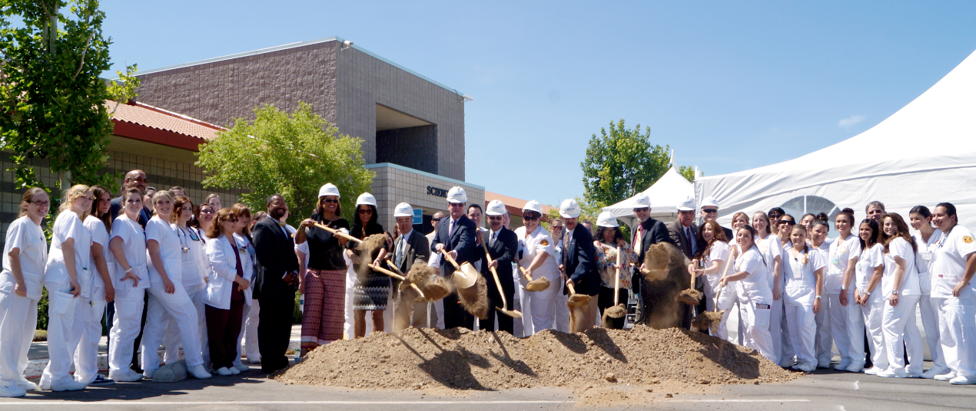
Dr. Prem Reddy Health & Sciences Building
Ground Breaking ceremony May 16, 2014
Construction schedule 12 months
Projected completion date is anticipated in June 2015
Occupancy date will be start of Fall Semester 2015

Slide 6
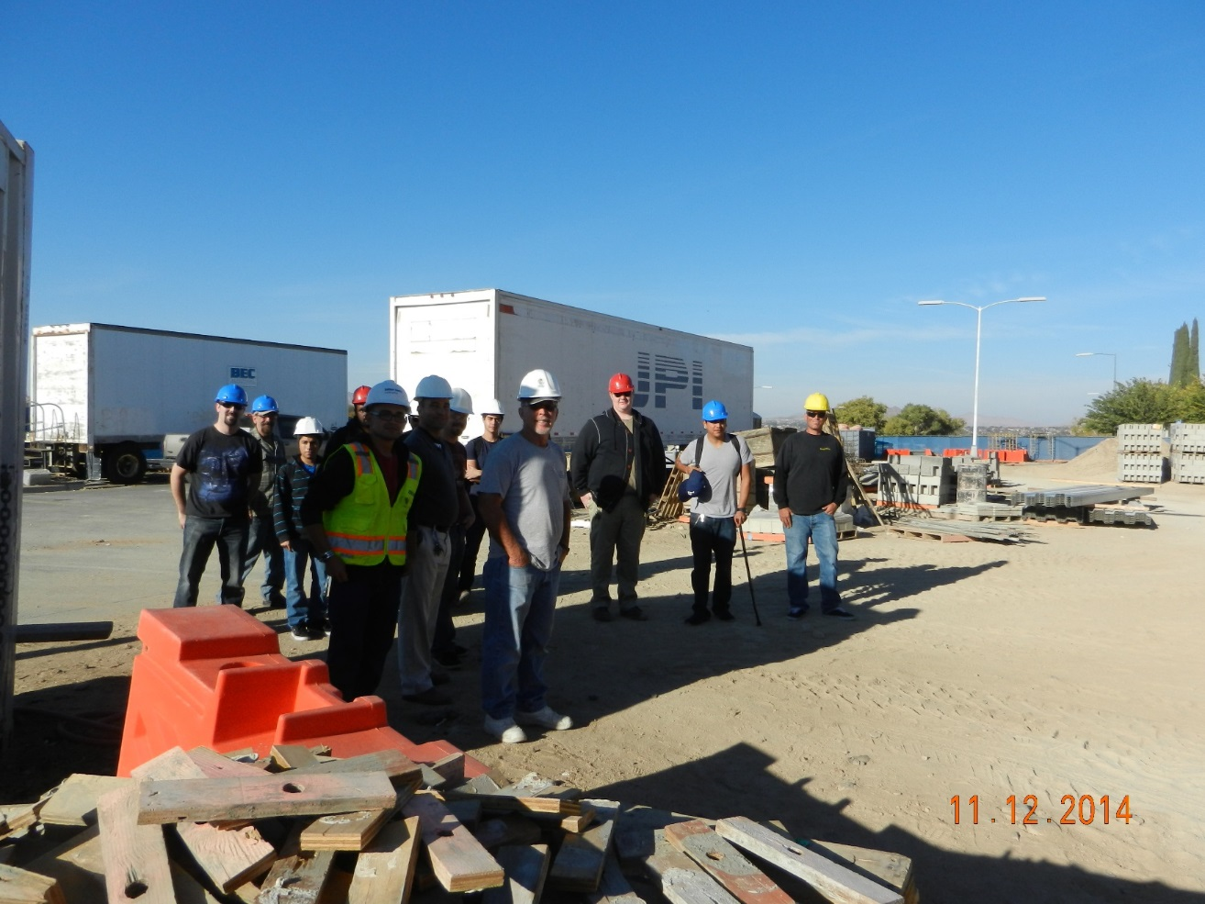

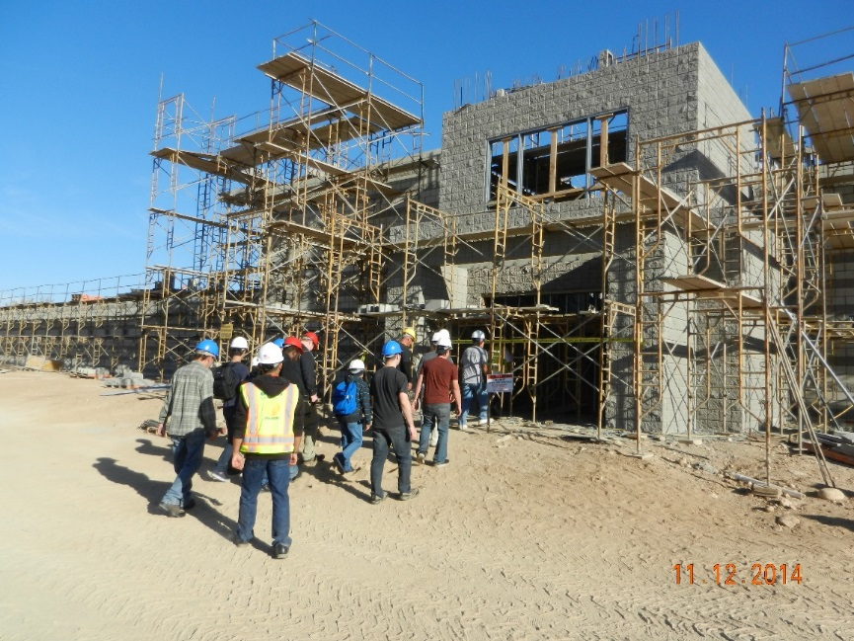
Construction Technology Class 106 on tour of building.
Balfour Beatty Superintendent has led several different classes on tours through the construction site.

Slide 7
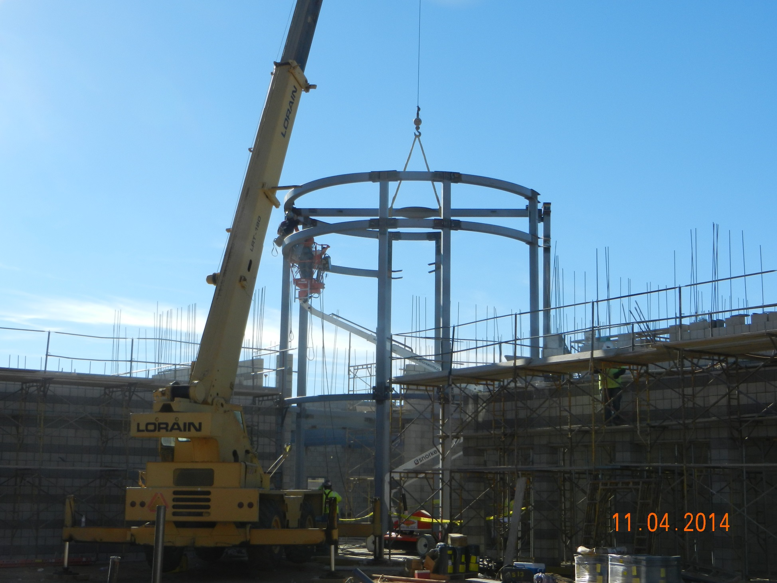

Slide 8
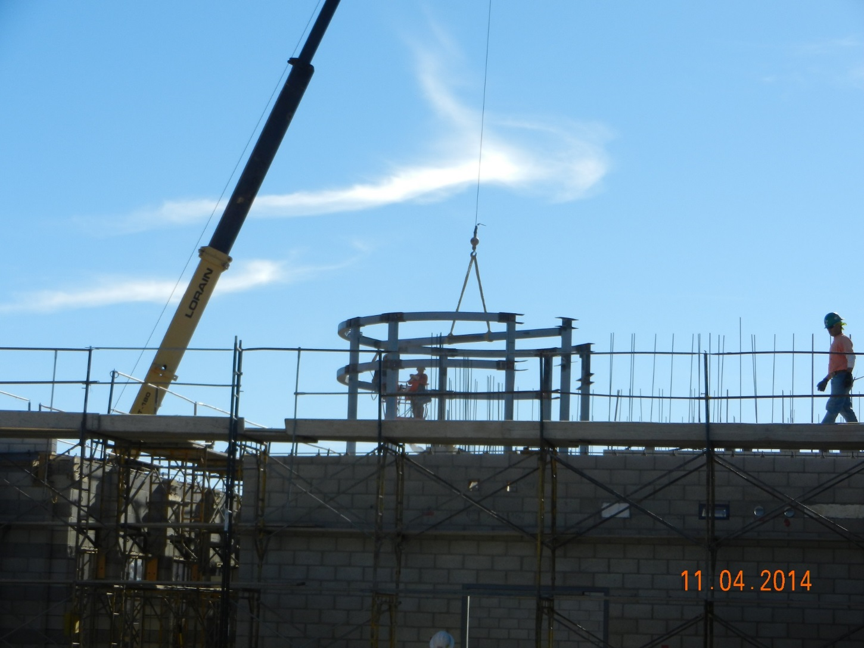
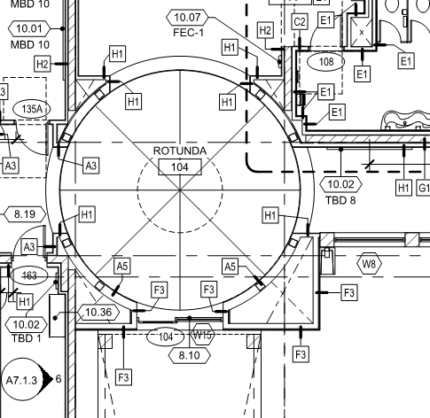
Another shot of the steel sub setting steel at rotunda. This is looking at rotunda from the nursing fundamentals space. The crane is sitting in the courtyard space between new and existing bldgs.

Slide 9
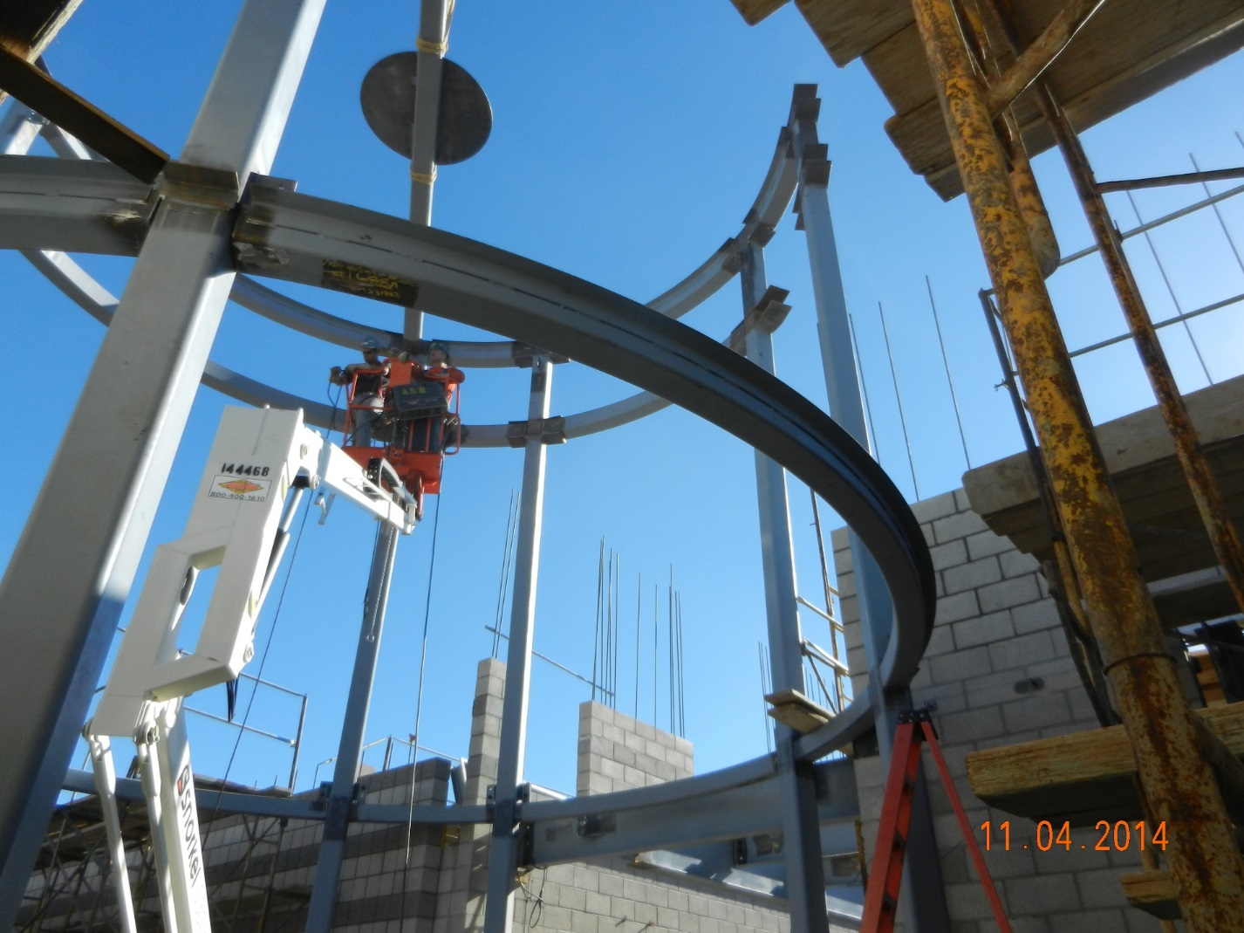
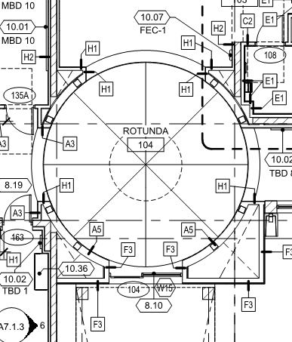
Structural Steel Contractor setting steel at rotunda.

Slide 10
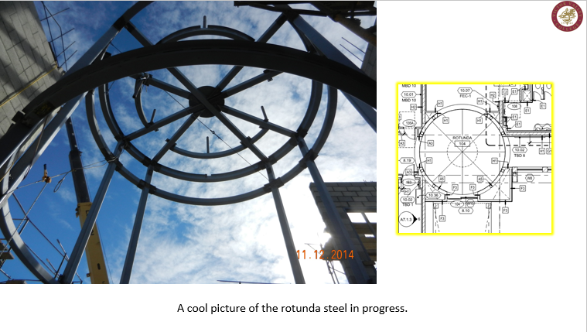

Slide 11
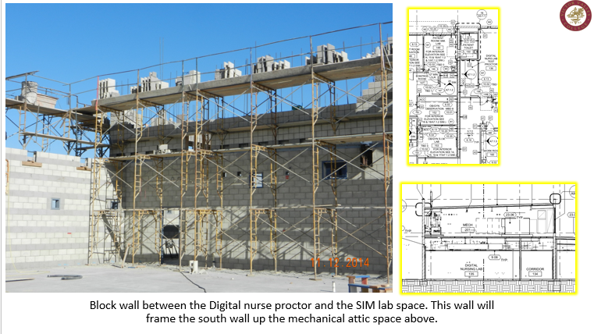

Slide 12
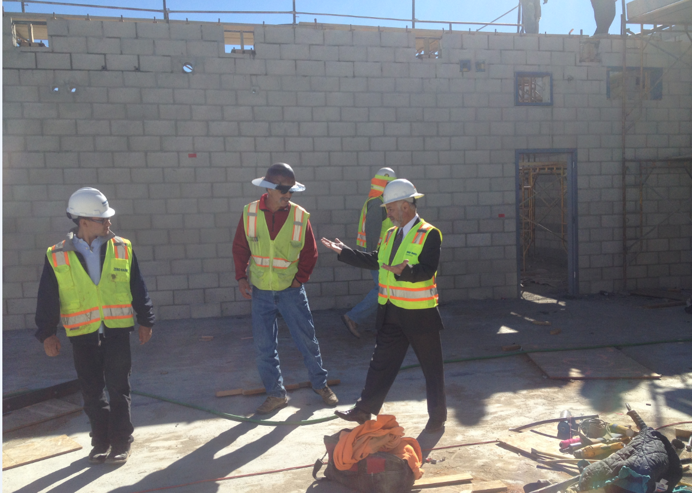

Slide 13
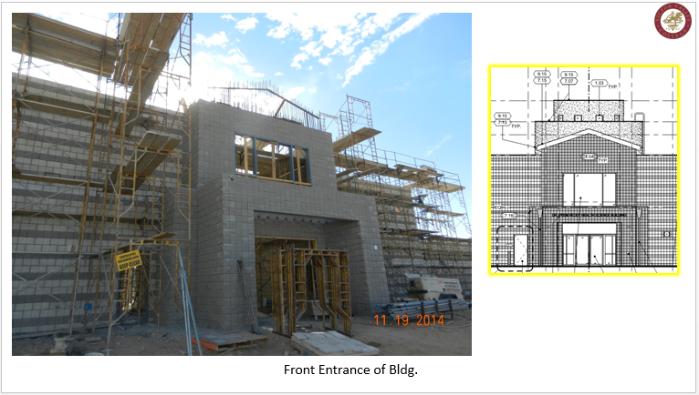

Slide 14
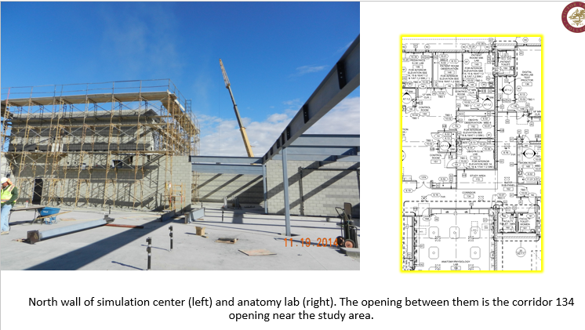

Slide 15
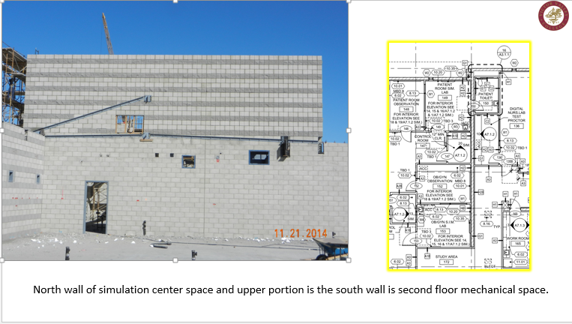

Slide 16
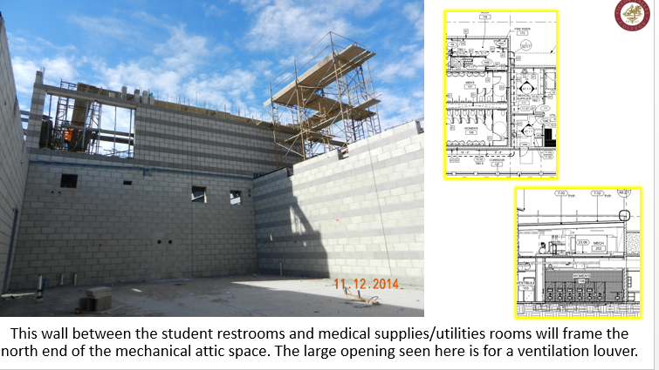

Slide 17
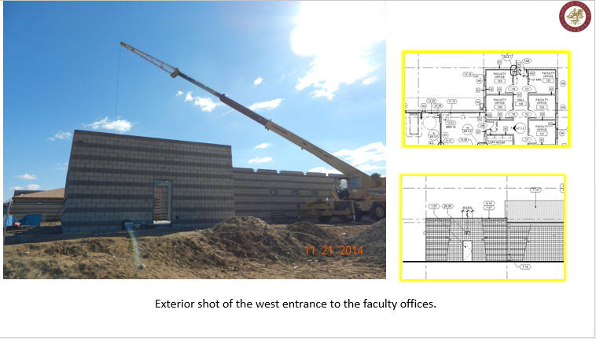

Slide 18
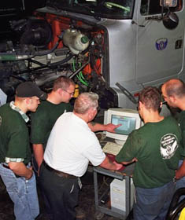
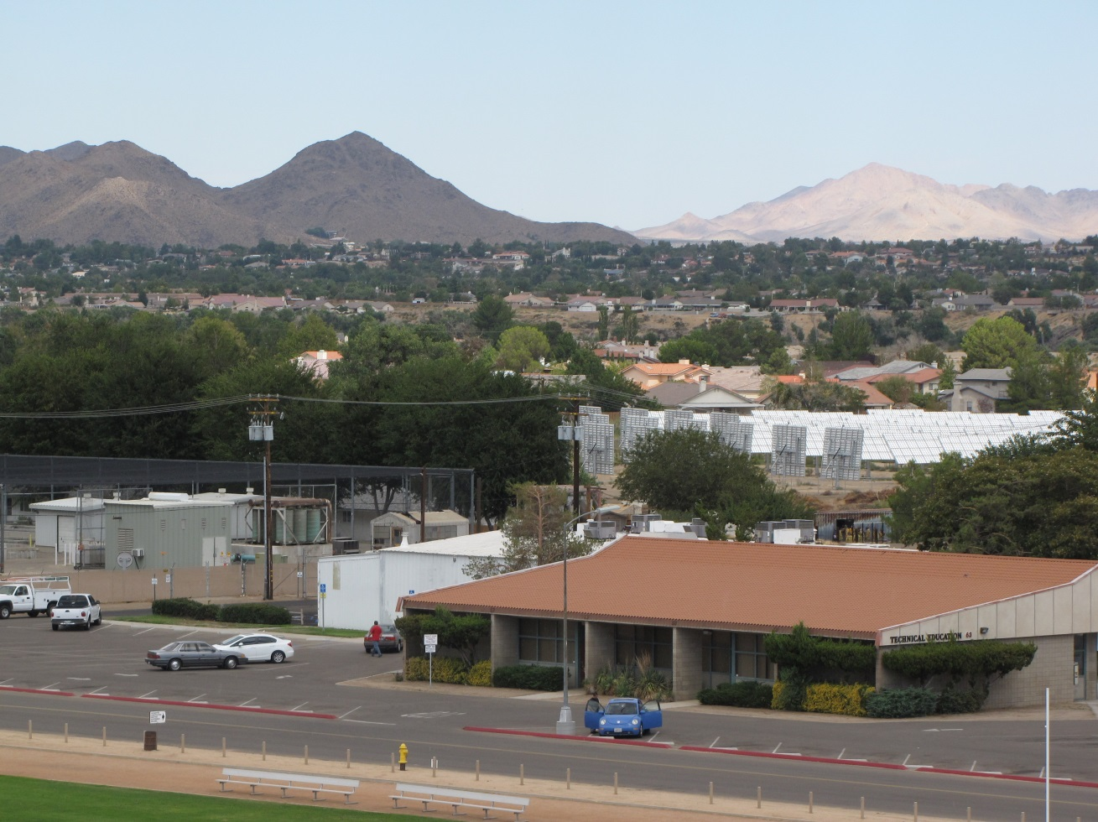


Vocational
Modernization

Slide 19
Vocational Complex Expansion / Renovation
Frick, Frick & Jette have been hired as the Design Professionals
Working drawings are anticipated to be completed by January 2015
The project will then be submitted to the Division of the State Architects office for approval
The Project will be bid and then go to the Board of Trustees for approval
Projected construction start date is anticipated for late Summer of 2015

Slide 20


Facilities Construction Website
www.vvc.edu/offices/facilities
You can view a live webcam of the construction of the Dr. Prem Reddy Health & Science Building at http://www.vvc.edu/offices/facilities/project-dr-prem-reddy-health-sciences-building.shtml

Slide 21
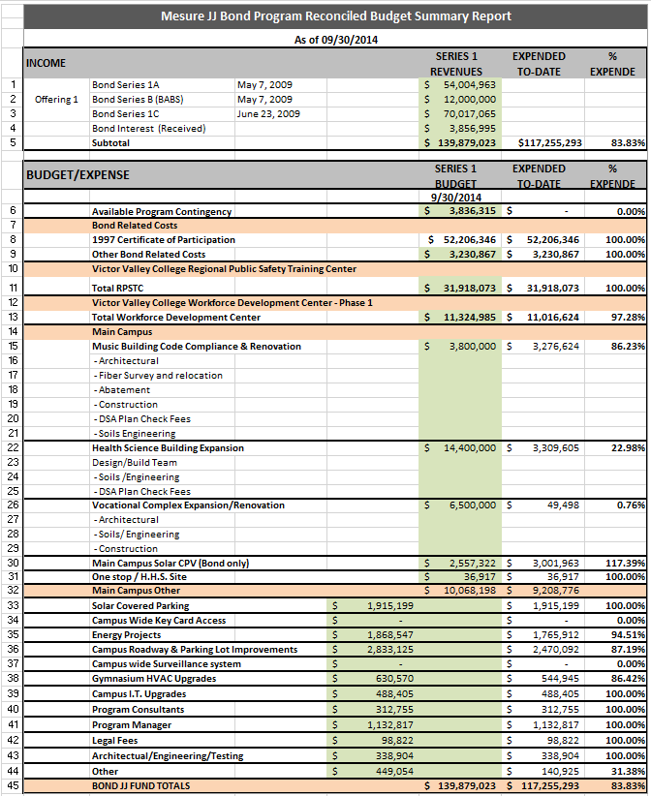

Slide 22
